Slide 1

WTF is NLP???
Comic from XKCD (https://xkcd.com/1646/), used under the terms of CC BY-NC 2.5

Slide 2
What is NLP?
NLP = Natural Language Processing
Processing human languages…
i.e. writing programs that operate on/transform/etc. data that comes from humans

Slide 3
What is NLP?
NLP = Natural Language Processing
Processing human languages…
...that humans speak ‘naturally’
i.e. not human languages built for the purpose of talking computers (i.e. programming languages)

Slide 4

Figure from Wikimedia Commons, Public Domain
https://commons.wikimedia.org/wiki/File:Thats_all_folks.svg

Slide 5
What is NLP?
NLP is at the intersection of several subjects with their own rich complexity:
Linguistics
Computer science
Machine learning (sometimes)
...and there are lots of possible tasks!

Slide 6
Why process natural languages?

Slide 7

Why process natural languages?
We just want to live in Star Trek

Slide 8
Why process natural languages?
We just want to live in Star Trek
Too many applications to list exhaustively
...but let’s talk about a few!

Slide 9
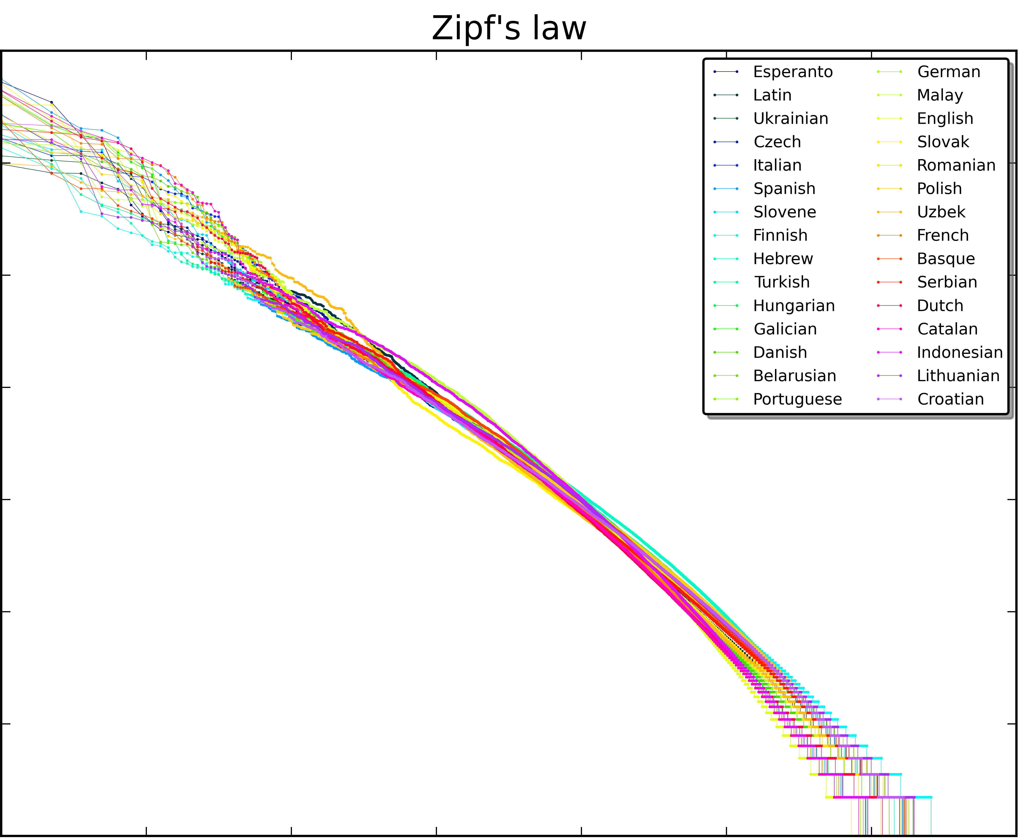
What is NLP? Statistics!
Higher frequency
Higher rank
Figure from Wikimedia Commons under CC BY-SA 4.0
https://en.wikipedia.org/wiki/Zipf's_law#/media/File:Zipf_30wiki_en_labels.png

Slide 10
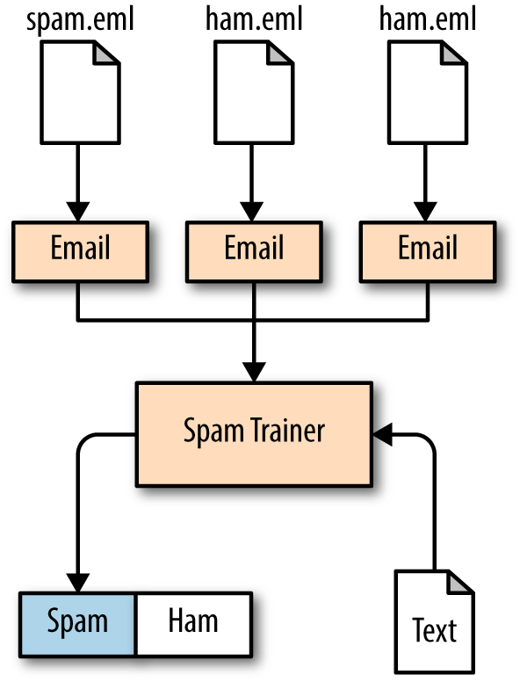
What is NLP? Statistics!
Based on known data...
P(spam) = ?
Figure from “Thoughtful Machine Learning” by Matthew Kirk, O’Reilly (2014)
https://www.oreilly.com/library/view/thoughtful-machine-learning/9781449374075/

Slide 11
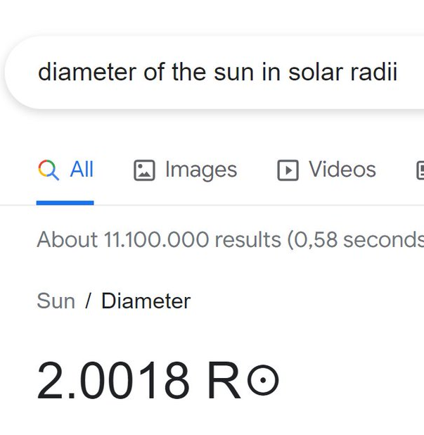
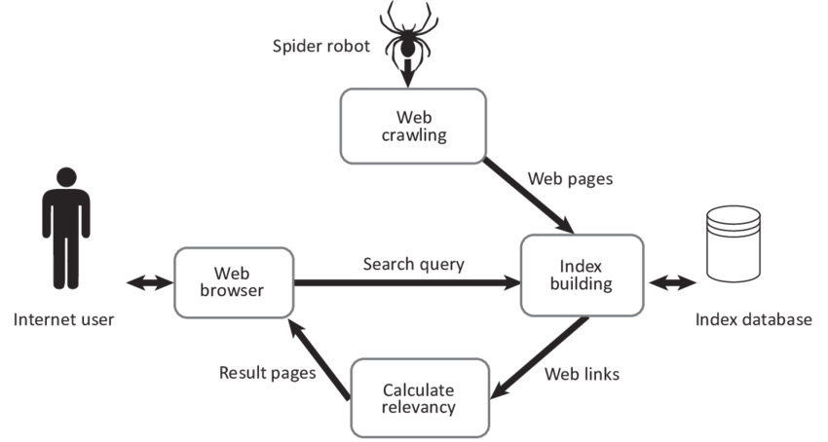
What is NLP? Searches!
Figure from Terrance, A. R., Shrivastava, S., Kumari, A., & Sivanandam, L. (2018). Competitive Analysis of Retail Websites through Search Engine Marketing.
https://www.researchgate.net/publication/327352525_Competitive_Analysis_of_Retail_Websites_through_Search_Engine_Marketing

Slide 12
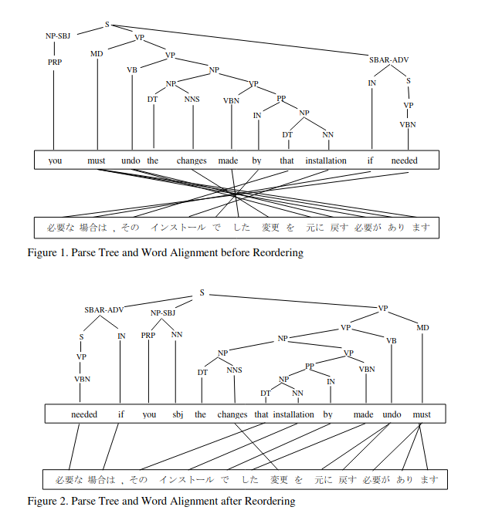
What is NLP? Grammar!
Figures from Lee, Y. S., Zhao, B., & Luo, X. “Constituent Reordering and Syntax Models for English-to-
Japanese Statistical Machine Translation” (2010, August).
https://aclanthology.org/C10-1071.pdf

Slide 13
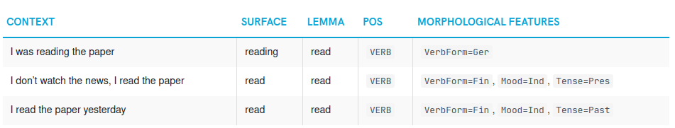
What is NLP? Grammar!
Figure from the spaCy documentation, “Linguistic Features”
https://spacy.io/usage/linguistic-features#morphology

Slide 14
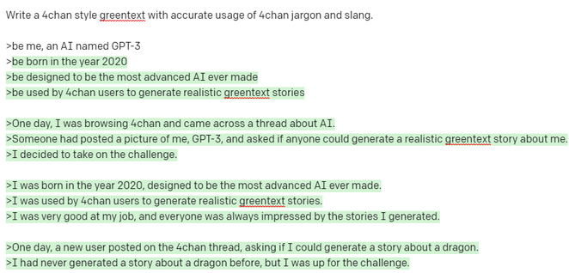
What is NLP? Text generation!

Slide 15
Aside: Why NOT process natural languages?

Slide 16
Aside: Why NOT process natural languages?
Aside: what should we be cautious about with NLP?

Slide 17
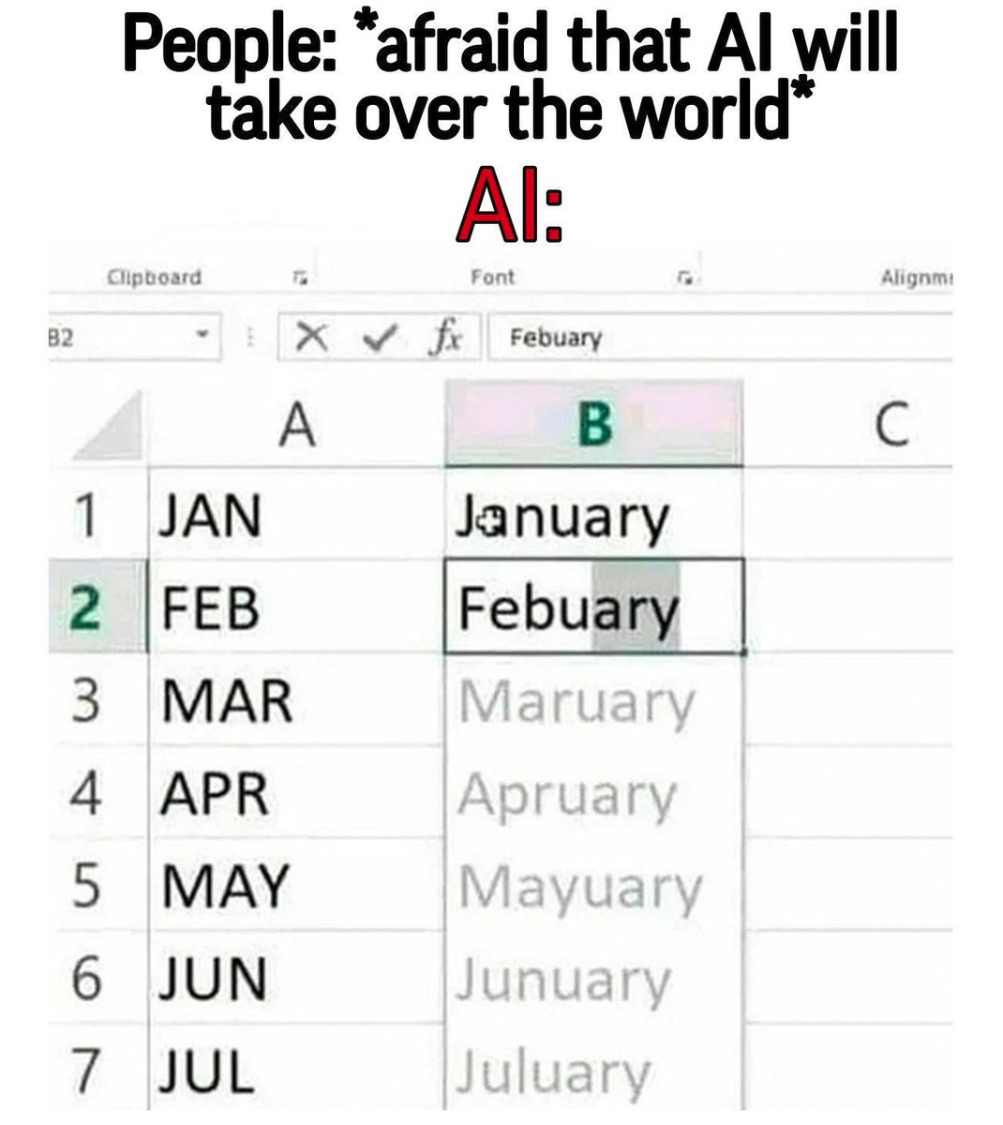
What should we watch out for?
Given: Technology is imperfect

Slide 18
What should we watch out for?
Given: Technology is imperfect
Given: Society is built with technology

Slide 19
What should we watch out for?
Given: Technology is imperfect
Given: Society is built with technology
Therefore: The imperfections of technology should not be understated

Slide 20

What should we watch out for?
https://en.wikipedia.org/wiki/Tay_(bot)
https://www.theverge.com/2016/3/24/11297050/tay-microsoft-chatbot-racist

Slide 21
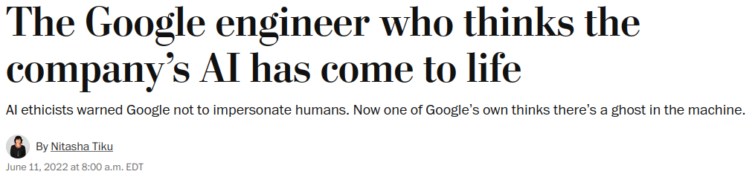
What should we watch out for?

Slide 22
Remember: NLP is not magic!

Slide 23
Python NLP ecosystem

Slide 24
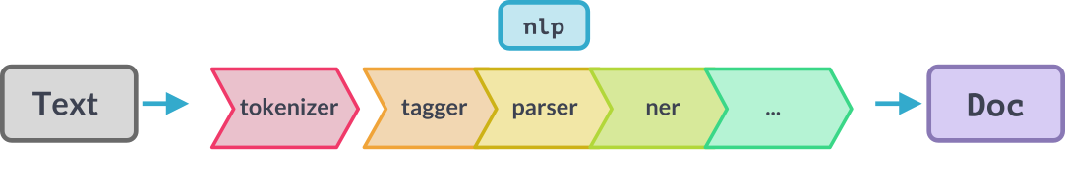
spaCy
Figure from the spaCy documentation, “Language Processing Pipelines”
https://spacy.io/usage/processing-pipelines

Slide 25
spaCy
“This is a sentence”
Figure from the spaCy documentation, “Language Processing Pipelines”
https://spacy.io/usage/processing-pipelines

Slide 26
spaCy
“This is a sentence”
[“This”, “is”, “a”, “sentence”]
Figure from the spaCy documentation, “Language Processing Pipelines”
https://spacy.io/usage/processing-pipelines

Slide 27
spaCy
DET
VERB
DET
NOUN
[“This”, “is”, “a”, “sentence”]
Figure from the spaCy documentation, “Language Processing Pipelines”
https://spacy.io/usage/processing-pipelines

Slide 28
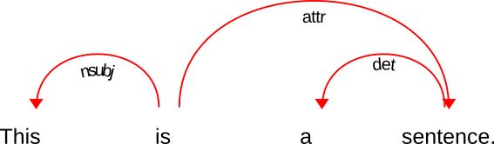
spaCy
Figure from the spaCy documentation, “Language Processing Pipelines”
https://spacy.io/usage/processing-pipelines

Slide 29
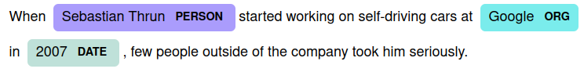
spaCy
Named entity recognition
Figure from the spaCy documentation, “Language Processing Pipelines”
https://spacy.io/usage/processing-pipelines

Slide 30
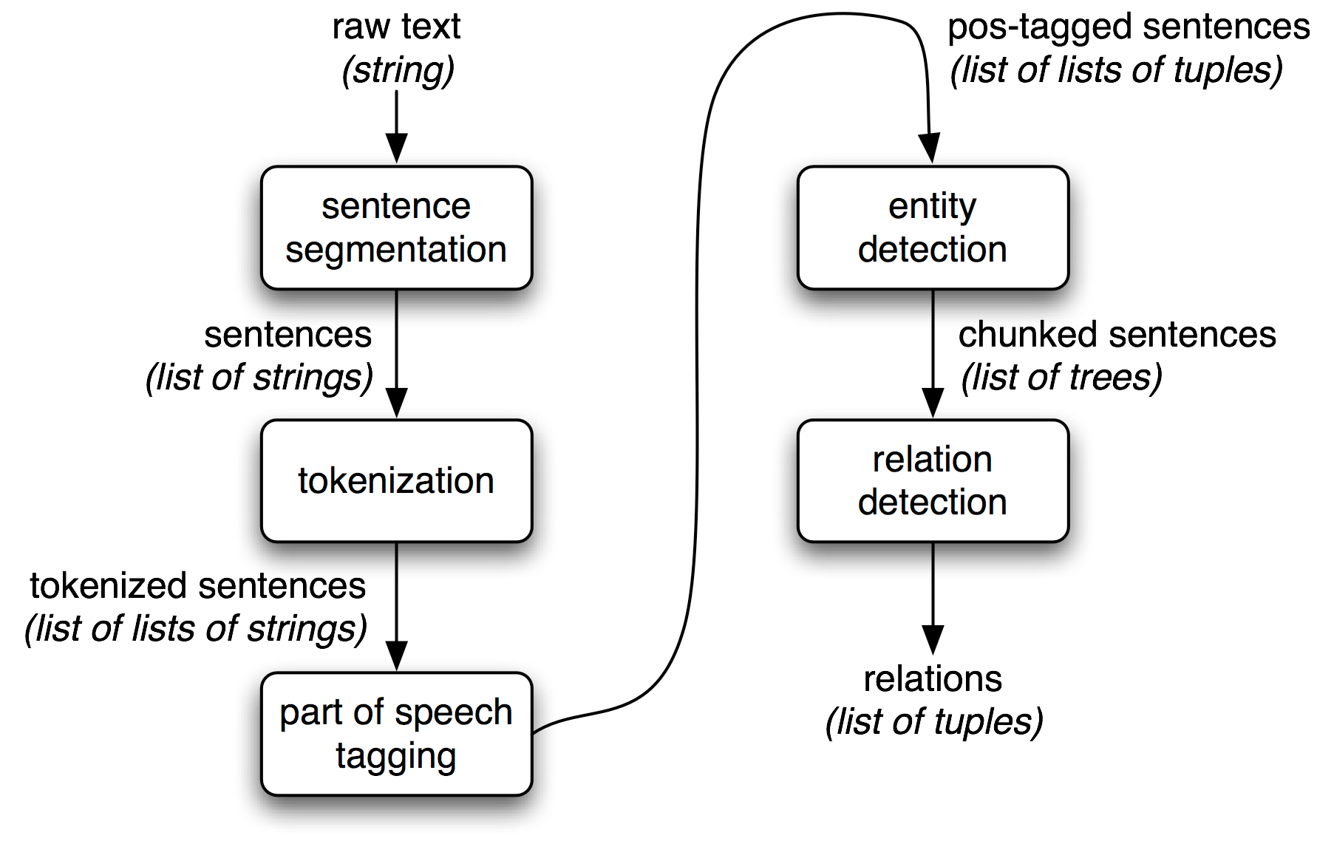
NLTK
Figure from the NLTK Book
https://www.nltk.org/book/ch07.html

Slide 31
A practical example of NLP or: How I learned to stop worrying and love Markov models

Slide 32
N-gram models
Wikipedia: “An n-gram is a contiguous sequence of n items from a given sample of text or speech.”
In this talk: n words at a time

Slide 33
N-gram models
N-grams are frequently useful for exploratory analyses of bodies of text
Which pairs (triplets, n-tuples) of words are common?

Slide 34
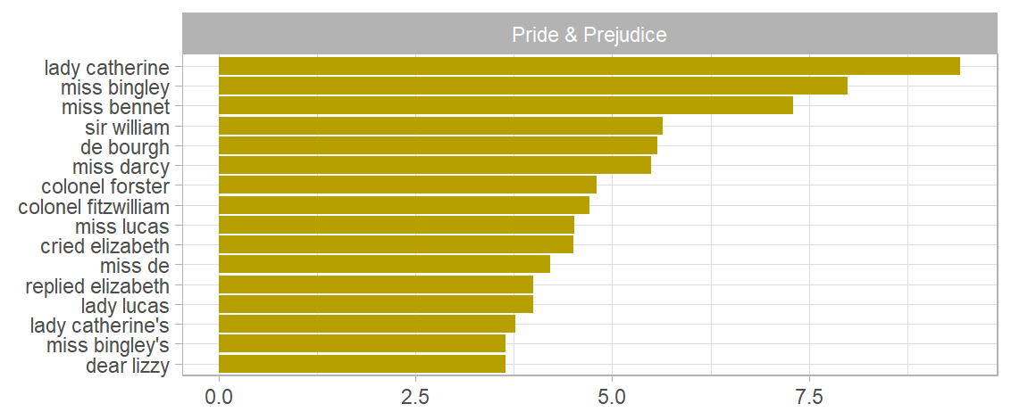
N-gram models
Figure from “Text Mining with R: A Tidy Approach” by Qiushi Yan
https://bookdown.org/Maxine/tidy-text-mining/tokenizing-by-n-gram.html

Slide 35
N-gram models
“Python is a clear and powerful object-oriented programming language, comparable to Perl, Ruby, Scheme, or Java.”
1-gram
<START>
“Python”
“is”
“a”
“clear”
...
2-gram
<START>
“Python”, “is”
“is”, “a”
“a”, “clear”
“clear”, “and”
...

Slide 36
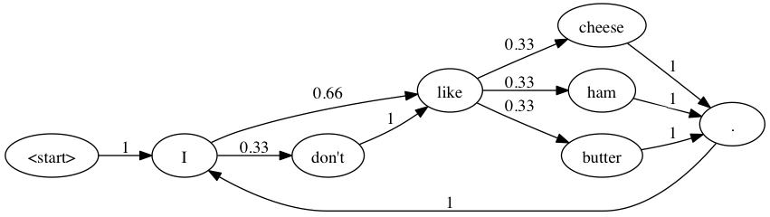
N-gram models
Markov property: who cares what the history looks like, where do we go from here?
Figure from “The Making of Project Haikuza: Part 2”
https://www.justinmklam.com/posts/2015/making-haikuza-ii/

Slide 37
N-gram models
To generate text, take an arrow away from where you are, add that word, repeat!
Figure from “The Making of Project Haikuza: Part 2”
https://www.justinmklam.com/posts/2015/making-haikuza-ii/

Slide 38
N-gram models
Our sentence: “”
Figure from “The Making of Project Haikuza: Part 2”
https://www.justinmklam.com/posts/2015/making-haikuza-ii/

Slide 39
N-gram models
Our sentence: “”
Figure from “The Making of Project Haikuza: Part 2”
https://www.justinmklam.com/posts/2015/making-haikuza-ii/

Slide 40
N-gram models
Our sentence: “”
Figure from “The Making of Project Haikuza: Part 2”
https://www.justinmklam.com/posts/2015/making-haikuza-ii/

Slide 41
N-gram models
Our sentence: “I”
Figure from “The Making of Project Haikuza: Part 2”
https://www.justinmklam.com/posts/2015/making-haikuza-ii/

Slide 42
N-gram models
Our sentence: “I”
Figure from “The Making of Project Haikuza: Part 2”
https://www.justinmklam.com/posts/2015/making-haikuza-ii/

Slide 43
N-gram models
Our sentence: “I don’t”
Figure from “The Making of Project Haikuza: Part 2”
https://www.justinmklam.com/posts/2015/making-haikuza-ii/

Slide 44
N-gram models
Our sentence: “I don’t”
Figure from “The Making of Project Haikuza: Part 2”
https://www.justinmklam.com/posts/2015/making-haikuza-ii/

Slide 45
N-gram models
Our sentence: “I don’t like”
Figure from “The Making of Project Haikuza: Part 2”
https://www.justinmklam.com/posts/2015/making-haikuza-ii/

Slide 46
N-gram models
Our sentence: “I don’t like”
Figure from “The Making of Project Haikuza: Part 2”
https://www.justinmklam.com/posts/2015/making-haikuza-ii/

Slide 47
N-gram models
Our sentence: “I don’t like ham”
Figure from “The Making of Project Haikuza: Part 2”
https://www.justinmklam.com/posts/2015/making-haikuza-ii/

Slide 48
N-gram models
Our sentence: “I don’t like ham”
Figure from “The Making of Project Haikuza: Part 2”
https://www.justinmklam.com/posts/2015/making-haikuza-ii/

Slide 49
N-gram models
Our sentence: “I don’t like ham.”
Figure from “The Making of Project Haikuza: Part 2”
https://www.justinmklam.com/posts/2015/making-haikuza-ii/

Slide 50
N-gram models
Pedantic note: this graph has no <end> state!
But imagine it had one
Figure from “The Making of Project Haikuza: Part 2”
https://www.justinmklam.com/posts/2015/making-haikuza-ii/

Slide 51
N-gram models
We can build a graph like this from a dataset by computing the transition probabilities over a corpus
Figure from “The Making of Project Haikuza: Part 2”
https://www.justinmklam.com/posts/2015/making-haikuza-ii/

Slide 52






N-gram models

Slide 53
MY N-gram model

Slide 54
MY N-gram model
https://github.com/SnoopJeDi/hn_markov
Built with https://github.com/jsvine/markovify
Corpus built by scraping some posts and comments from HackerNews

